Slide 1
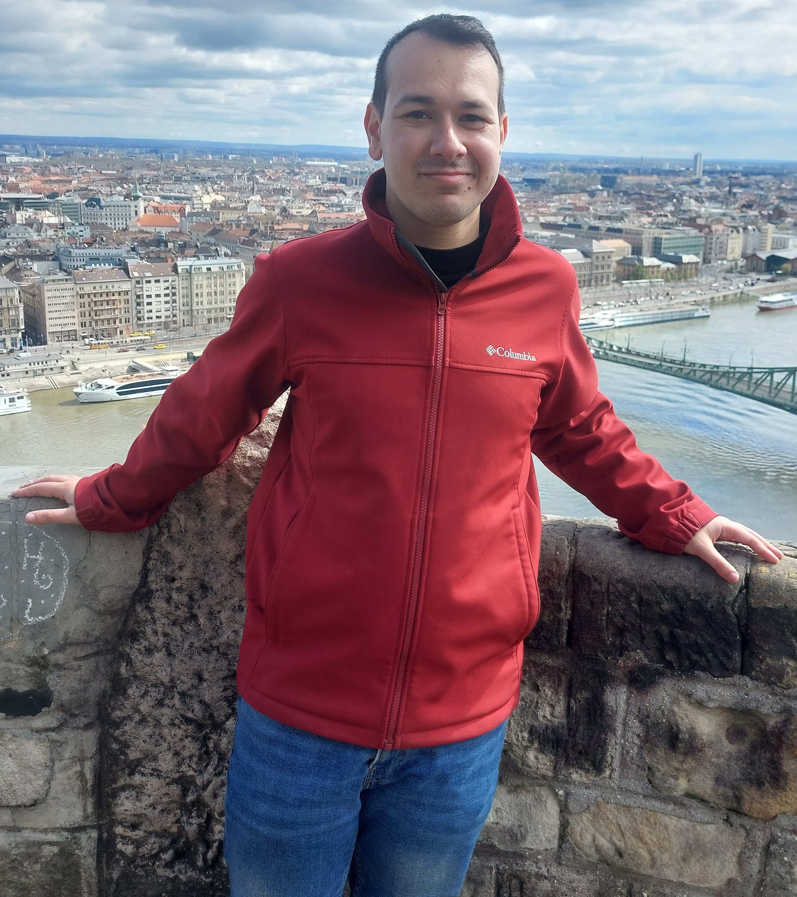
Course: Image Processing 31651 Micro Project 1 (MP1) : Convert Color Image to Grayscale Image (N=1)
Presentation date: 1/8/2024 on laboratory session (V=1)
Photo of the student | Shorten Name | ID
 | pony | 2210 | Student #1
 | shienfeld | XXXXXEFGH | Student #2
 | akimov | XXXXXIJKL | Student #3

Slide 2
Course: Image Processing 31651 Micro Project 1 (MP1) : Convert Color Image to Grayscale Image (N=1)
Presentation contains:
# | Description
1 | Description of the problem to be solved
2 | Description of the algorithm including description of: Input Image(s), algorithm’ parameter(s), output image(s)/value(s)
3 | Detailed Block chart (Flow Chart/Block Diagram) of the algorithm(s)
4 | Extracts of the important parts of the code with proper comments
5 | Examples of the code operation by using images selected by students including a discussion when algorithm’ worked and when not
6 | List of sources used (Bibliography)

Slide 3

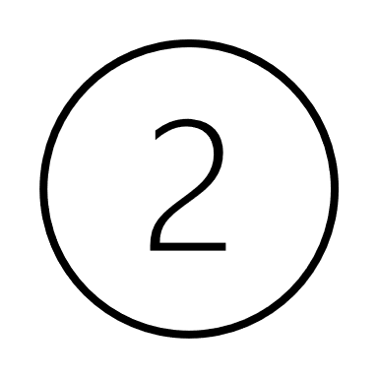
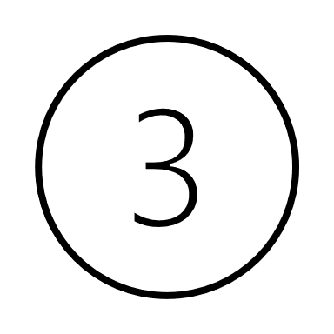
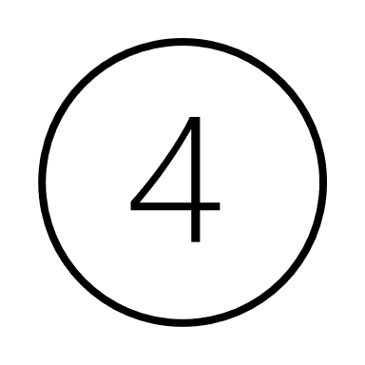
P1.1 Description of the problem to be solved –part 1
Grayscale images reduce the amount of data that needs to be processed, as they contain only intensity information compared to three channels (red, green, and blue) in color images.
This reduction in data simplifies algorithms and decreases computational load. [6]
Consequently - With fewer data points to process, operations on grayscale images are generally faster, which is crucial for real-time applications such as video processing.
Grayscale images require less storage space and memory compared to color images, making them more efficient for storage and processing. [6]
Many image processing techniques, such as edge detection, histogram equalization, and thresholding, are simpler to implement and perform more efficiently on grayscale images.
Combining photos taken in different weather conditions into one panoramic picture can make them look as if they were taken at the same time and under the same weather conditions.

Slide 4
P1.1 Description of the problem to be solved –part 2
Some reasons from academic papers explaining the significance of using grayscale images instead of RGB images
“Conversion of color image to grayscale image is one of the image processing applications used in different fields effectively. In publication organizations’ printing, a color image is expensive compared to a grayscale image. Thus, color images have converted to grayscale image to reduce the printing cost for low priced edition books. Similarly, color deficient viewer requires good quality of grayscale image to perceive the information, as the normal people perceive the color picture. Likewise, various image processing applications require conversion of color image to grayscale image for different purpose.” (Color Image to Grayscale Image Conversion) [5]
“Many medical imaging techniques, such as X-rays and MRIs, produce grayscale images. Machine learning algorithms can be used to analyze these images to identify abnormalities and diseases. By focusing on the grayscale values of the pixels, machine learning algorithms can detect subtle changes that would be difficult to see with the naked eye.” (Gray Scaling with the Algorithms) [1]
Color information is useless for distinguishing significant edges and features in numerous
applications. In image processing, a gray image discards much-unrequired data in a color image. The
primary drawback of colour-to-grey conversion is eliminating the visually significant image pixels. (Color to Grayscale Image Conversion Based on Singular Value Decomposition) [4]

Slide 5
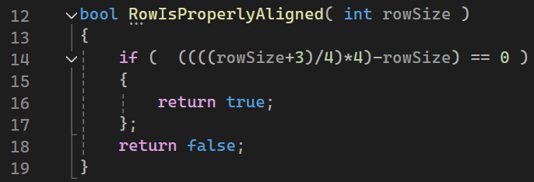
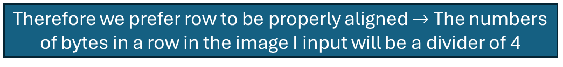
Intoduction to P1.2 – conditions to ensure an image is suitable to be an input of the system – part 2
Processor works on integers always – therefore if we will try to use number of bytes that does not characterize integers, we will have a problems
Therefore we prefer row to be properly aligned $→$ The numbers of bytes in a row in the image I input will be a divider of 4
Pay attention that every image in that project will be 320x240 with 3 colors - therefore this condition is inherently satisfied

Slide 6
Intoduction to P1.2 – conditions to ensure an image is suitable to be an input of the system – part 2
Color depth, also known as bit depth, refers to the number of bits used to represent the color of a single pixel in an image. The more bits per pixel, the more colors can be represented.
We are dealing with two types of images: True Color (24-bit RGB) images and Grayscale (8-bit) images.
True Color Images (24-bit RGB):
Each pixel is 24 bits (3 bytes).
Represented by three values: Blue, Green, Red.
Checked in the code to ensure the BMP file has 24 bits per pixel.

Slide 7
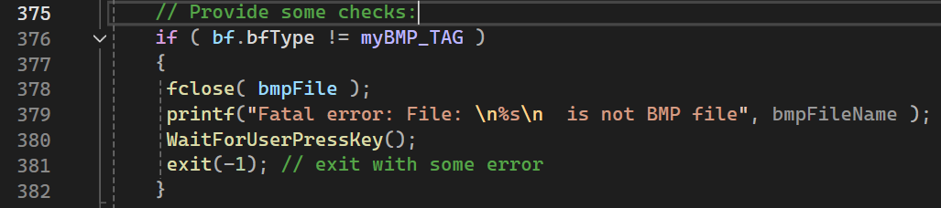
Intoduction to P1.2 – conditions to ensure an image is suitable to be an input of the system – part 2
The BMP file must have the correct signature, represented by myBMP_TAG. This ensures the file being processed is indeed a BMP file.
The file signature is checked using bf.bfType == myBMP_TAG.

Slide 8
P1.2 Description of the algorithms – part 1
Load a "True color" image with a size of 320x240 pixels
Average Algorithm
Luminosity Algorithm
Single color channel Algorithm
Lightness Algorithm
Store the resulted image as a BMP file in the directory of the code

Slide 9
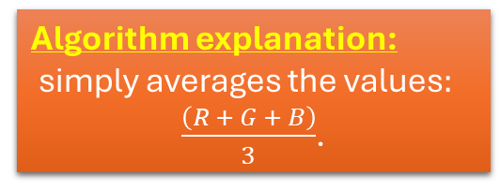
P1.2 Description of the algorithms – part 2
Input Image(s) : The algorithm takes one "True color" image with a size of 320x240 pixels. (predefined in the attached header file)
Algorithm Parameters :
one parameter: 0.33 (division by 3)
Benefits of the algorithm:
This formula generates a reasonably nice grayscale equivalent, and its simplicity makes it easy to implement and optimize.
However, this formula is not without shortcomings - while fast and simple, it does a poor job of representing shades of gray relative to the way humans perceive luminosity (brightness).
Algorithm explanation:
simply averages the values$:$
$\frac{\left(R + G + B\right)}{3}$.
Average Algorithm
Output Image(s):
This algorithm produces one grayscale image with a size of 320x240 pixels.
drawbacks of the algorithm:
Because humans do not perceive all colors equally, the “average method” of grayscale conversion is inaccurate.

Slide 10
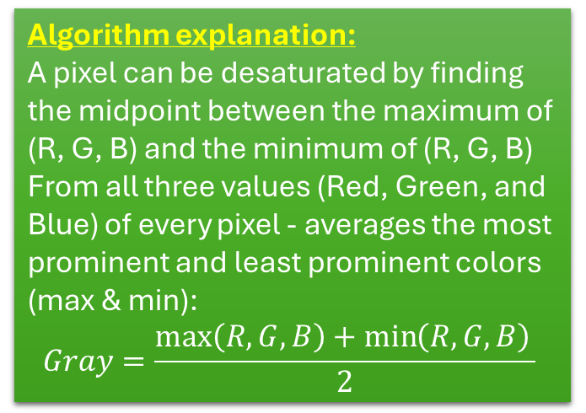
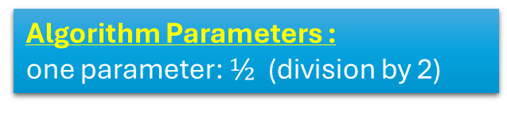
P1.2 Description of the algorithms – part 3
Algorithm Parameters :
one parameter: $½$ (division by 2)
Input Image(s) : The algorithm takes one "True color" image with a size of 320x240 pixels. (predefined in the attached header file)
a maximum decomposition provides a brighter grayscale image, while a minimum decomposition provides a darker one. This method of grayscale reduction is typically used for artistic effect. [7]
Benefits of the algorithm:
Lightness results in a flatter, softer grayscale image. If you compare this desaturated sample to the human-eye-corrected sample, you should notice a difference in the contrast of the image.
So that method tends to reduce contrast.
Lightness Algorithm
(or desaturation Algorithm)
Algorithm explanation:
A pixel can be desaturated by finding the midpoint between the maximum of (R, G, B) and the minimum of (R, G, B)
From all three values (Red, Green, and Blue) of every pixel - averages the most prominent and least prominent colors (max & min):
$$Gray=\frac{\max\left(R,G,B\right)+\min\left(R,G,B\right)​}{2}$$
Another look of the algorithm:
“To calculate Grayscale, we can use the Lightness component of the HSL (Hue, Saturation, Lightness) color space.” [3]
Output Image(s):
This algorithm produces one grayscale image with a size of 320x240 pixels.

Slide 11
P1.2 Description of the algorithms – part 4
Algorithm Parameters :
First parameter (R) : 0.21, second parameter (G) : 0.72, third parameter (B) : 0.07
Input Image(s) : The algorithm takes one "True color" image with a size of 320x240 pixels. (predefined in the attached header file)
Benefits of the algorithm 1:
This algorithm plays off the fact that cone density in the human eye is not uniform across colors. Humans perceive green more strongly than red, and red more strongly than blue. This makes sense from an evolutionary biology standpoint - much of the natural world appears in shades of green, so humans have evolved greater sensitivity to green light. [7]
Benefits of the algorithm 2:
Instead of treating red, green, and blue light equally, a good grayscale conversion will weight each color based on how the human eye perceives it.
Luminosity Algorithm
Algorithm explanation:
A more sophisticated version of the average method. It also averages the values, but it forms a weighted average to account for human perception. We’re more sensitive to green than other colors, so green is weighted most heavily.
Output Image(s):
This algorithm produces one grayscale image with a size of 320x240 pixels.

Slide 12
P1.2 Description of the algorithms – part 5
The source to the fourth algorithm is: https://tannerhelland.com/2011/10/01/grayscale-image-algorithm-vb6.html
Input Image(s) : The algorithm takes one "True color" image with a size of 320x240 pixels. (predefined in the attached header file)
Algorithm Parameters :
none
“Believe it or not, this weak algorithm is the one most digital cameras use for taking “grayscale” photos. CCDs in digital cameras are comprised of a grid of red, green, and blue sensors, and rather than perform the necessary math to convert RGB values to gray ones, they simply grab a single channel (green, for the reasons mentioned in Method #2 - human eye correction) and call that the grayscale one. For this reason, most photographers recommend against using your camera’s built-in grayscale option. Instead, shoot everything in color and then perform the grayscale conversion later, using whatever method leads to the best result.” [7]
Benefits of the algorithm:
The fastest computational method for grayscale reduction - using data from a single-color channel.
Unlike all the methods mentioned so far, this method requires no calculations.
Single color channel Algorithm
Output Image(s):
This algorithm produces one grayscale image with a size of 320x240 pixels.
Algorithm explanation:
All it does is pick a single channel and make that the grayscale value

Slide 13
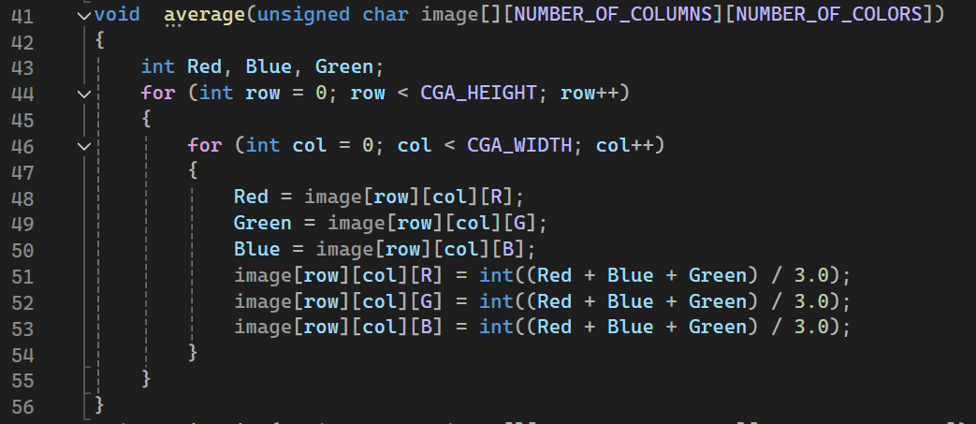
P1.4 Extracts of the important parts of the code with proper comments – part 1
The average method converts a color image to grayscale by computing the average of the Red, Green, and Blue components for each pixel. This method is straightforward and considers all three-color channels equally.
For each pixel in the image:
Extract the Red, Green, and Blue components. For example in line 48 : Red=image[row][col][R];
Compute the average of the three components: $\frac{Red + Green + Blue}{3}$
Set the Red, Green, and Blue components of the pixel to this grayscale value.

Slide 14
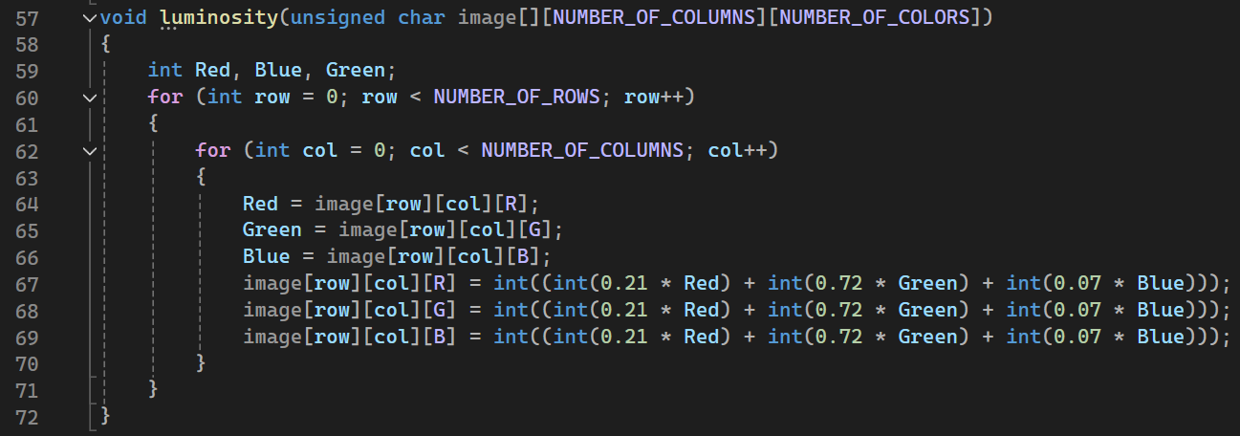
P1.4 Extracts of the important parts of the code with proper comments – part 2
The luminosity method converts a color image to grayscale by taking a weighted sum of the Red, Green, and Blue components. This method accounts for human perception, giving more importance to the Green component as the human eye is more sensitive to green light.
For each pixel in the image:
Extract the Red, Green, and Blue components. For example in line 64 : Red=image[row][col][R];
Compute the grayscale value using the formula$: 0.21 ∗ Red + 0.72 ∗ Green + 0.07 ∗ Blue$
Set the Red, Green, and Blue components of the pixel to this grayscale value.

Slide 15
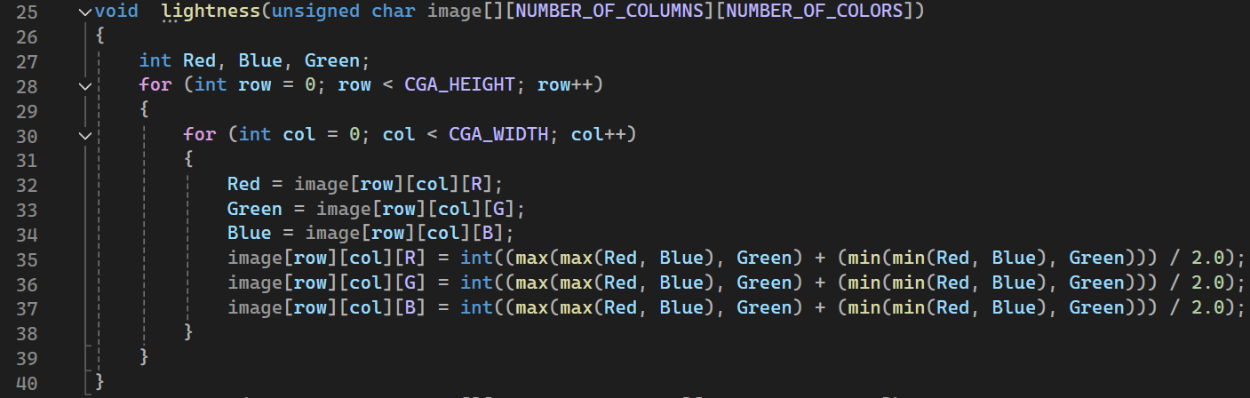
P1.4 Extracts of the important parts of the code with proper comments – part 3
The lightness method converts a color image to grayscale by taking the average of the maximum and minimum RGB values of each pixel. This method considers the extremes of the color range, making it sensitive to the lightest and darkest parts of the image.
For each pixel in the image:
Extract the Red, Green, and Blue components. For example in line 32 : Red=image[row][col][R];
Calculate the maximum value among the three components: $max⁡(Red, Green, Blue)$
Calculate the minimum value among the three components: $min⁡(Red, Green, Blue)$
Compute the grayscale value as the average of the maximum and minimum values: $\frac{\max{+}min}{2}$ $→$ and Set the Red, Green, and Blue components of the pixel to this grayscale value.

Slide 16
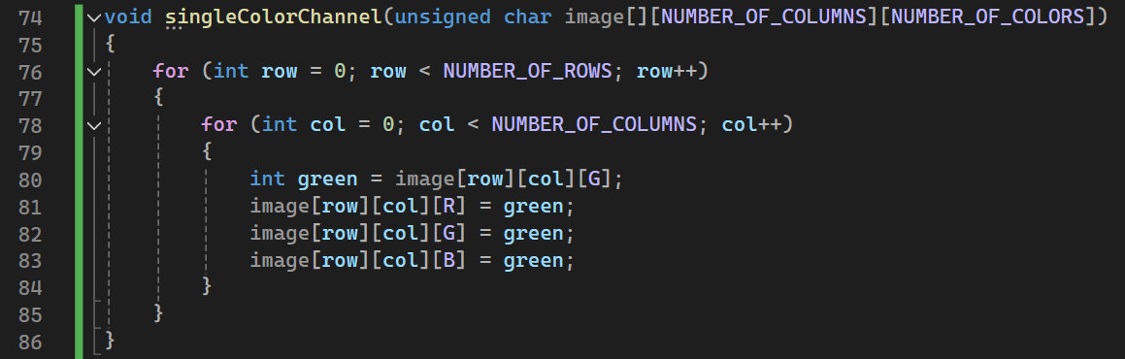
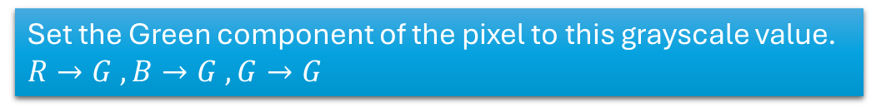
P1.4 Extracts of the important parts of the code with proper comments – part 4
The Single-Color Channel method simplifies the conversion of a color image to grayscale by using the intensity value from one of the color channels (red, green, or blue) for all three channels of the grayscale image. This method is straightforward and computationally efficient. The green channel is often chosen because the human eye is more sensitive to green light, providing a balanced representation of the image's brightness.
For each pixel in the image:
Extract the Green component only. For example in line 80 : Red=image[row][col][G];
Set the Green component of the pixel to this grayscale value.
$R→G , B→G , G→G$
This method retains the detail and brightness of the original image by focusing on the green channel only.

Slide 17
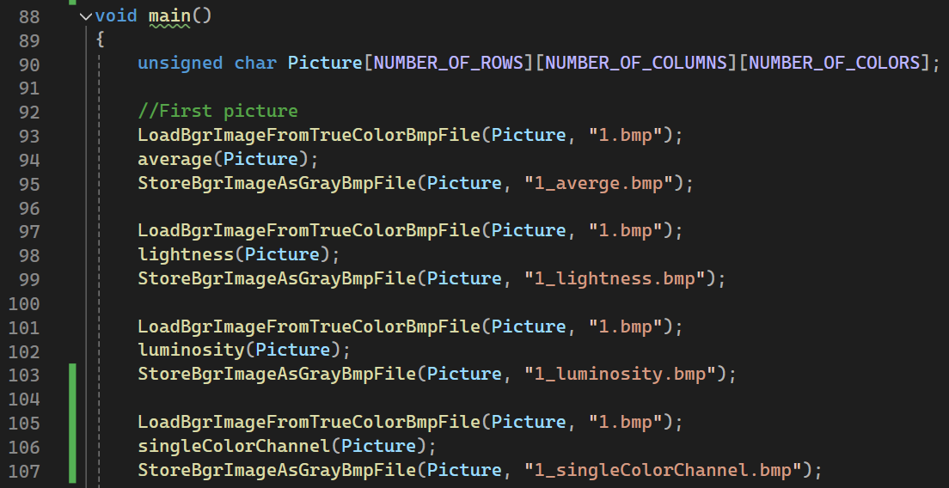
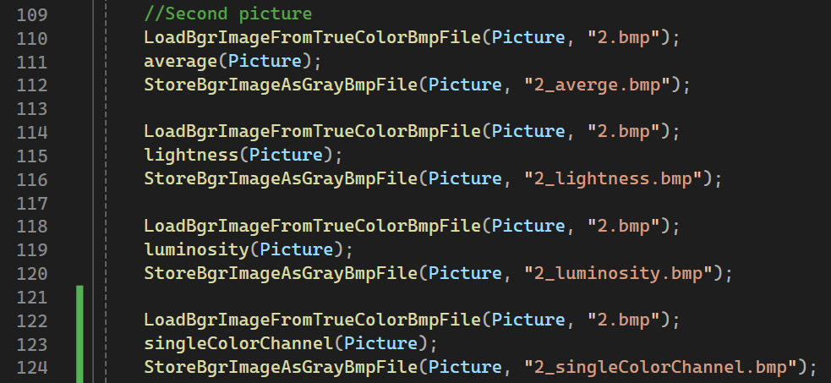
P1.4 Extracts of the important parts of the code with proper comments – part 5
The function LoadBgrImageFromTrueColorBmpFile(Picture, "filename") loads a BMP image into the Picture array.
Several grayscale conversion functions (average, lightness, luminosity, and singleColorChannel) are applied to the image data stored in the Picture array.
After each conversion, the processed image is saved using StoreBgrImageAsGrayBmpFile(Picture, "filename").
The process is repeated for different images (e.g., "1.bmp", "2.bmp"), and each image is processed and saved multiple times with different grayscale methods.

Slide 18
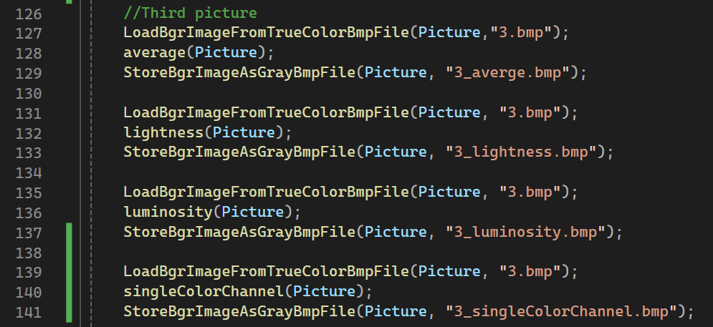
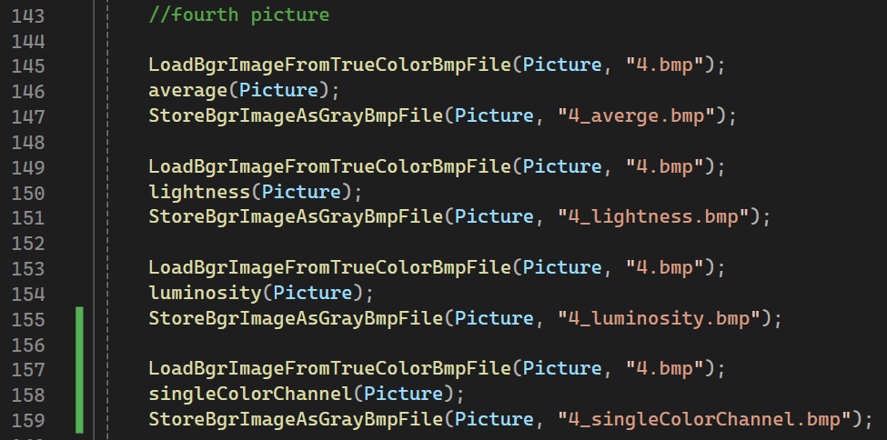
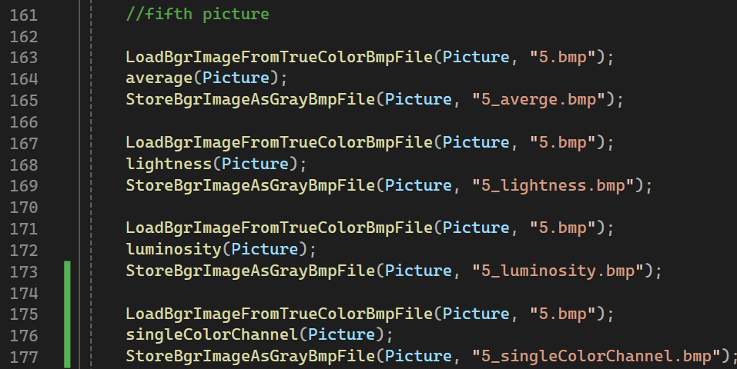
P1.4 Extracts of the important parts of the code with proper comments – part 6
The processes described in the previews slide are applied again for total amount of 5 examples each converted with 4 different algorithms

Slide 19
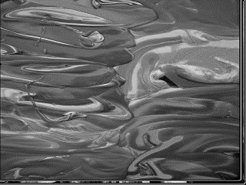
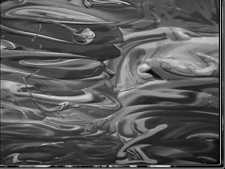
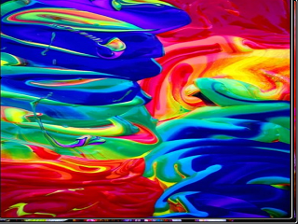
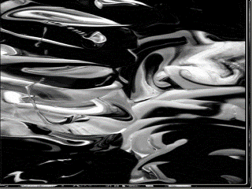
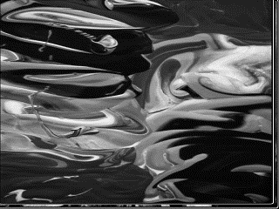
P1.5 Examples of the code operation by using images selected by students – part 1
(2) Using “lightness algorithm”
(1) Using “average algorithm”
(3) Using “SCH Algorithm”
(4) Using “luminosity algorithm”
SCH=single color channel

Slide 20
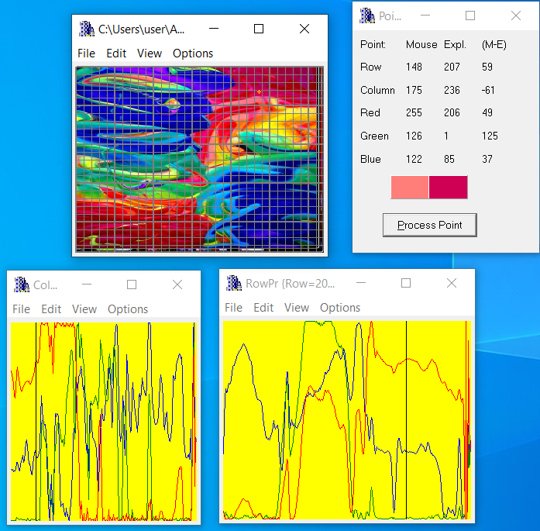
P1.5 Examples of the code operation by using images selected by students – part 4
The original photo

Slide 21
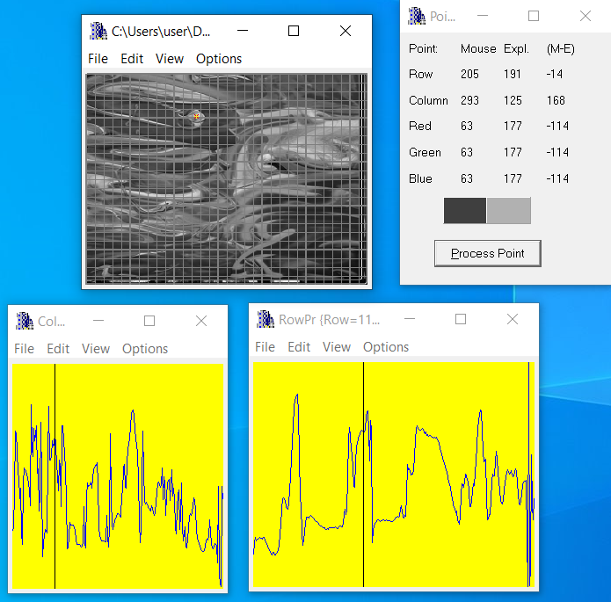
P1.5 Examples of the code operation by using images selected by students – part 5
Using “average algorithm”

Slide 22
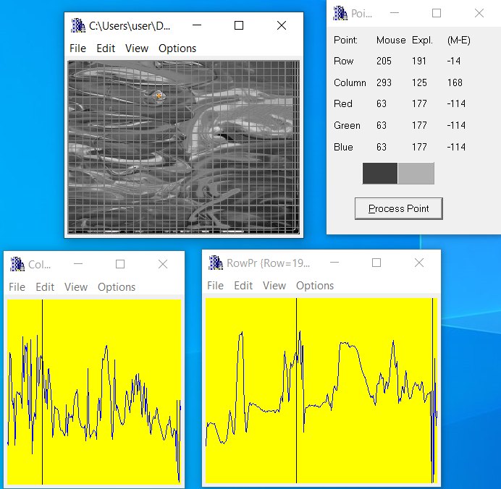
P1.5 Examples of the code operation by using images selected by students – part 6
Using “lightness algorithm”

Slide 23
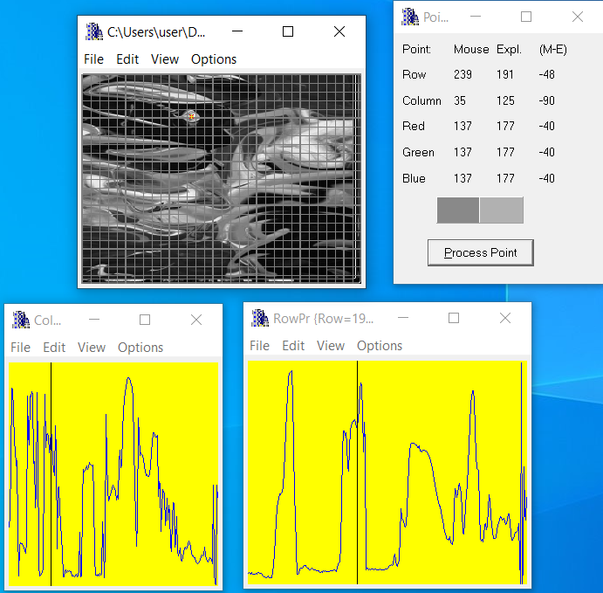
P1.5 Examples of the code operation by using images selected by students – part 7
Using “luminosity algorithm”

Slide 24
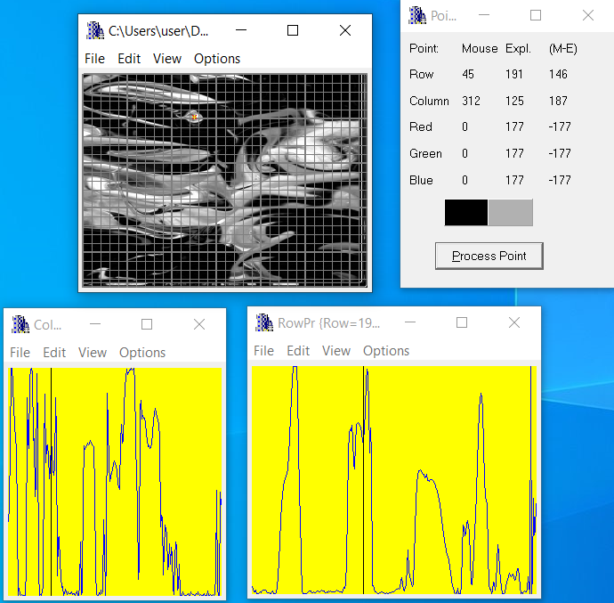
P1.5 Examples of the code operation by using images selected by students – part 7
Using “Single color
channel Algorithm”

Slide 25
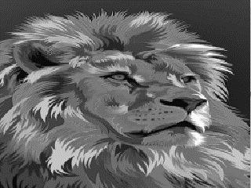
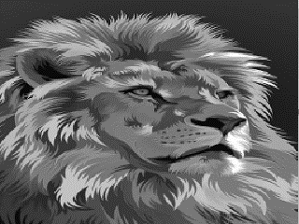
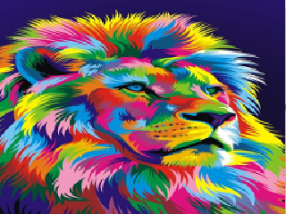
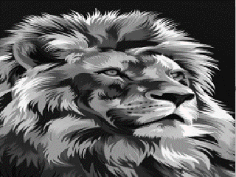
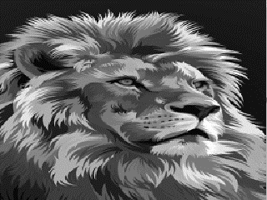
P1.5 Examples of the code operation by using images selected by students – part 1
(2) Using “lightness algorithm”
(1) Using “average algorithm”
(3) Using “SCH Algorithm”
(4) Using “luminosity algorithm”
SCH=single color channel

Slide 26
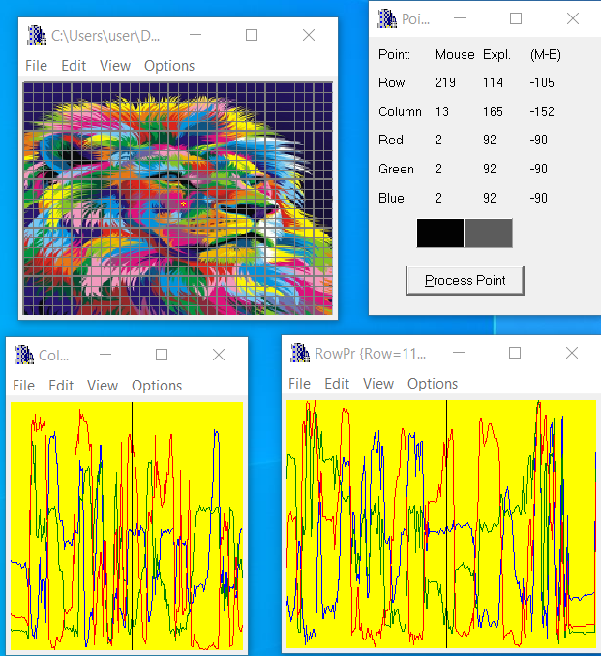
P1.5 Examples of the code operation by using images selected by students – part 1
The original photo

Slide 27
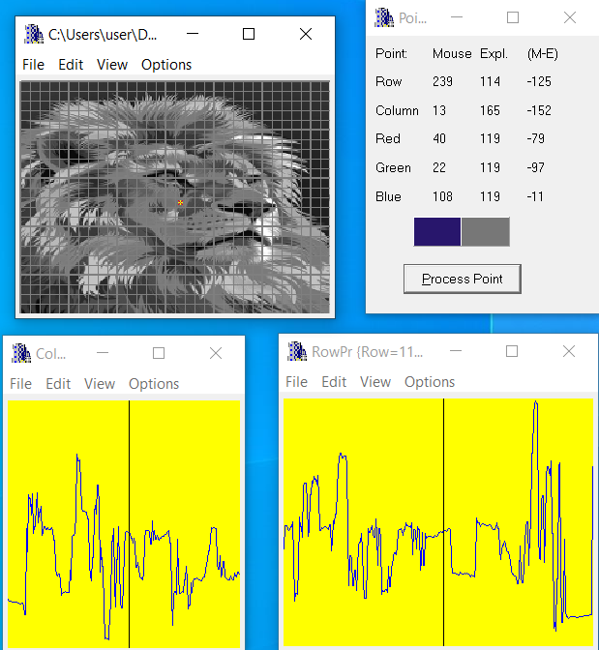
P1.5 Examples of the code operation by using images selected by students – part 2
Using “average algorithm”

Slide 28
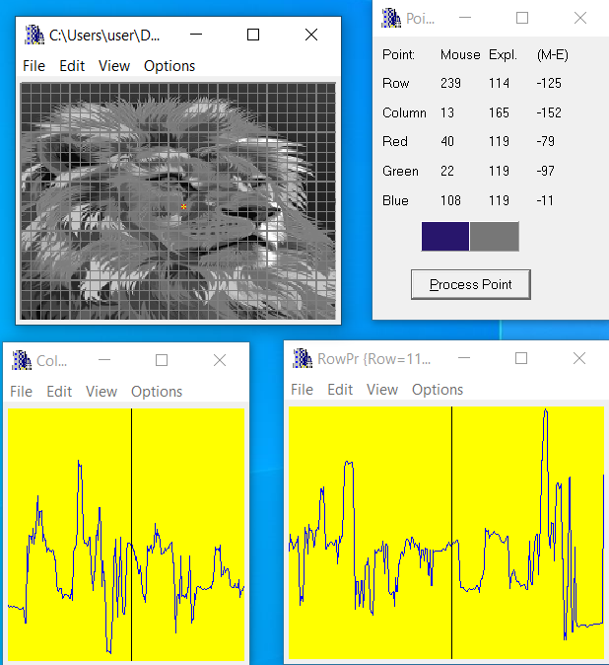
P1.5 Examples of the code operation by using images selected by students – part 3
Using “lightness algorithm”

Slide 29
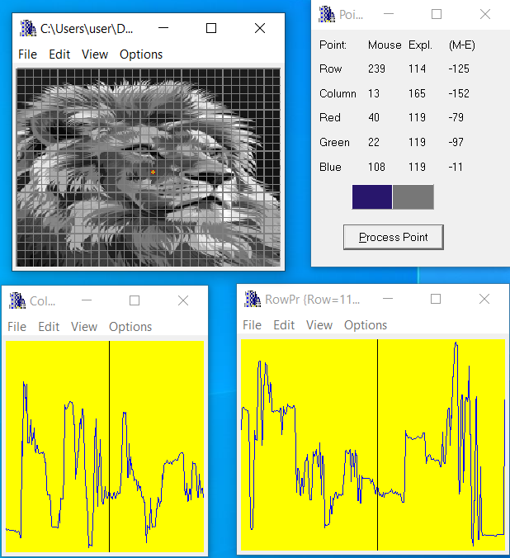
P1.5 Examples of the code operation by using images selected by students – part 4
Using “luminosity algorithm”

Slide 30
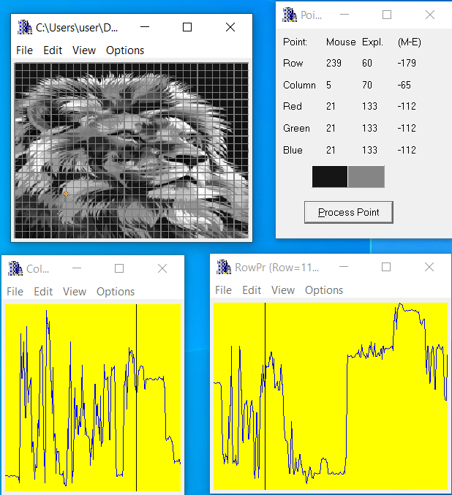
P1.5 Examples of the code operation by using images selected by students – part 5
Using “Single color
channel Algorithm”

Slide 31
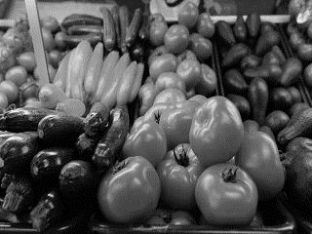
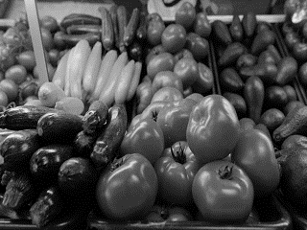
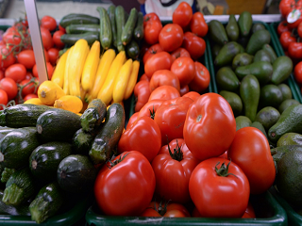
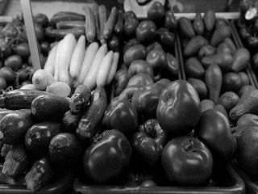
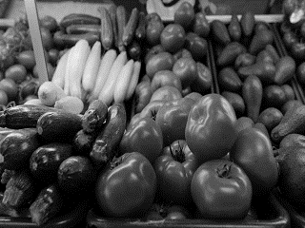
P1.5 Examples of the code operation by using images selected by students – part 1
(2) Using “lightness algorithm”
(1) Using “average algorithm”
(3) Using “SCH Algorithm”
(4) Using “luminosity algorithm”
SCH=single color channel

Slide 32
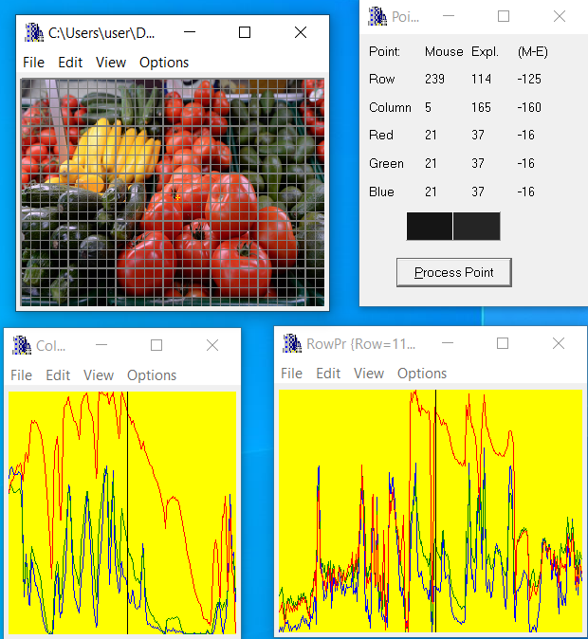
P1.5 Examples of the code operation by using images selected by students – part 1
The original photo

Slide 33
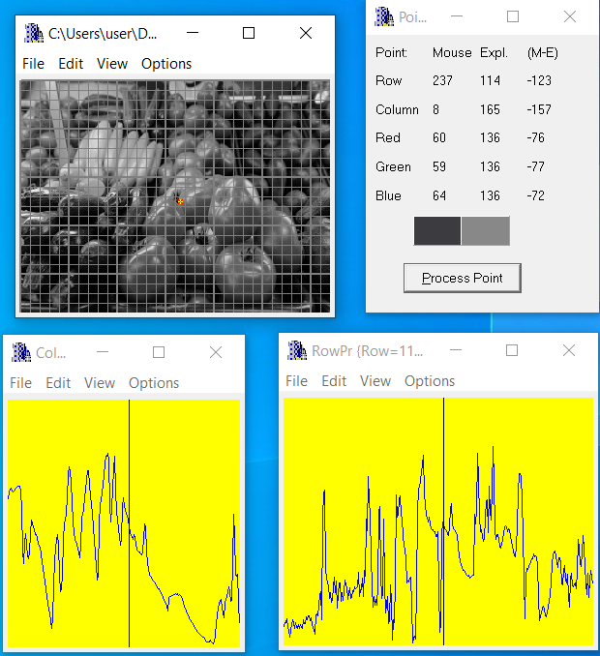
P1.5 Examples of the code operation by using images selected by students – part 1
Using “average algorithm”

Slide 34
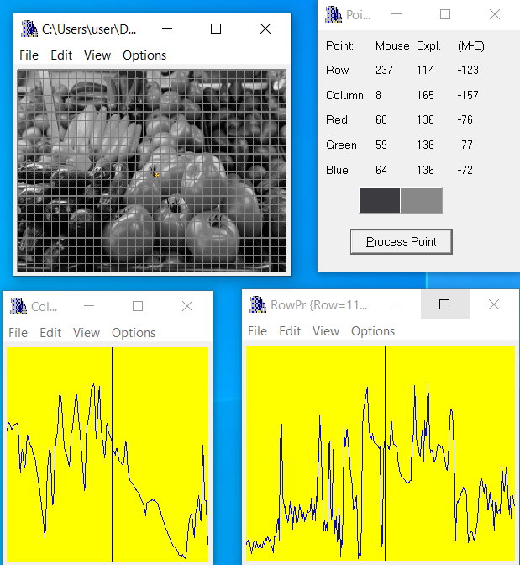
P1.5 Examples of the code operation by using images selected by students – part 1
Using “lightness algorithm”

Slide 35

P1.5 Examples of the code operation by using images selected by students – part 1
Using “luminosity algorithm”

Slide 36
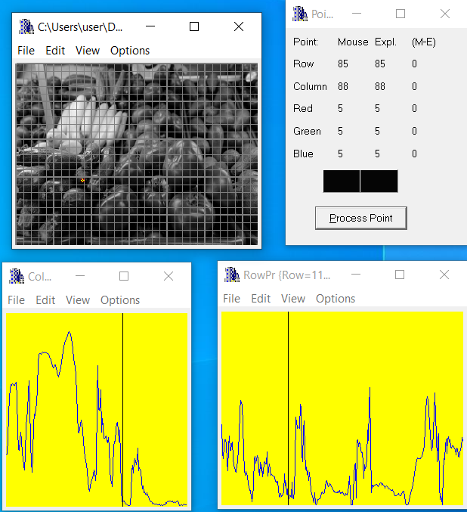
P1.5 Examples of the code operation by using images selected by students – part 1
Using “Single color
channel Algorithm”

Slide 37
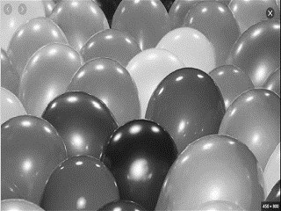




P1.5 Examples of the code operation by using images selected by students – part 1
(2) Using “lightness algorithm”
(1) Using “average algorithm”
(3) Using “SCH Algorithm”
(4) Using “luminosity algorithm”
SCH=single color channel

Slide 38





P1.5 Examples of the code operation by using images selected by students – part 1
(2) Using “lightness algorithm”
(1) Using “average algorithm”
(3) Using “SCH Algorithm”
(4) Using “luminosity algorithm”
SCH=single color channel

Slide 39
P1.5 Examples of the code operation by using images selected by students – part 5

Slide 40
P1.5 Examples of the code operation by using images selected by students – part 6

Slide 41
P1.5 Examples of the code operation by using images selected by students – part 7

Slide 42
P1.6 List of sources used (Bibliography) – part 1
https://medium.com/@mjbharmal2002/gray-scaling-with-the-algorithms-b83f87975885
[1] Gray Scaling with the Algorithms / Mustafa Bharmal - Nov 3, 2023
https://do-marlay-ka-moonh.medium.com/converting-color-images-to-grayscale-ab0120ea2c1e
[2] Converting Color Images to Grayscale - Sep 25, 2017 – In medium
https://fiveko.com/convert-rgb-to-grayscale-algorithms/
[3] = Algorithms for RGB to Grayscale conversion
https://ieeexplore.ieee.org/stamp/stamp.jsp?tp=&arnumber=10132453
[4] Color to Grayscale Image Conversion Based on Singular Value Decomposition (SVD)
https://ieeexplore.ieee.org/document/5445596
[5] Color Image to Grayscale Image Conversion
https://www.jeremymorgan.com/tutorials/opencv/how-to-grayscale-image/?source=post_page-----b83f87975885-
[6] Grayscaling Images Made Simple with OpenCV
[7] Seven grayscale conversion algorithms (with pseudocode and VB6 source code)
-Tanner Helland -Oct 1, 2011
https://tannerhelland.com/2011/10/01/grayscale-image-algorithm-vb6.html

Slide 43
P1.6 List of sources used (Bibliography) – part 2
RGB to Grayscale Conversion-
Mustafa Murat ARAT-May 13, 2020
https://mmuratarat.github.io/2020-05-13/rgb_to_grayscale_formulas
https://tannerhelland.com/2011/10/01/grayscale-image-algorithm-vb6.html
Seven grayscale conversion algorithms (with pseudocode and VB6 source code)
-Tanner Helland -Oct 1, 2011
https://e2eml.school/convert_rgb_to_grayscale
How to Convert an RGB Image to Grayscale
How to Convert an RGB Image to a Grayscale / by Panagiotis Antoniadis & Michal Aibin on March 18, 2024
https://www.baeldung.com/cs/convert-rgb-to-grayscale

